Slide 1
Introduction
Project goal was to analyze well data from the Alberta and BC geographic region to infer formation characteristics
First and third parts focused on aggregating data from well and pressure test lists
Second part required creating interactive software to process diagnostic fracture injection tests

Slide 2
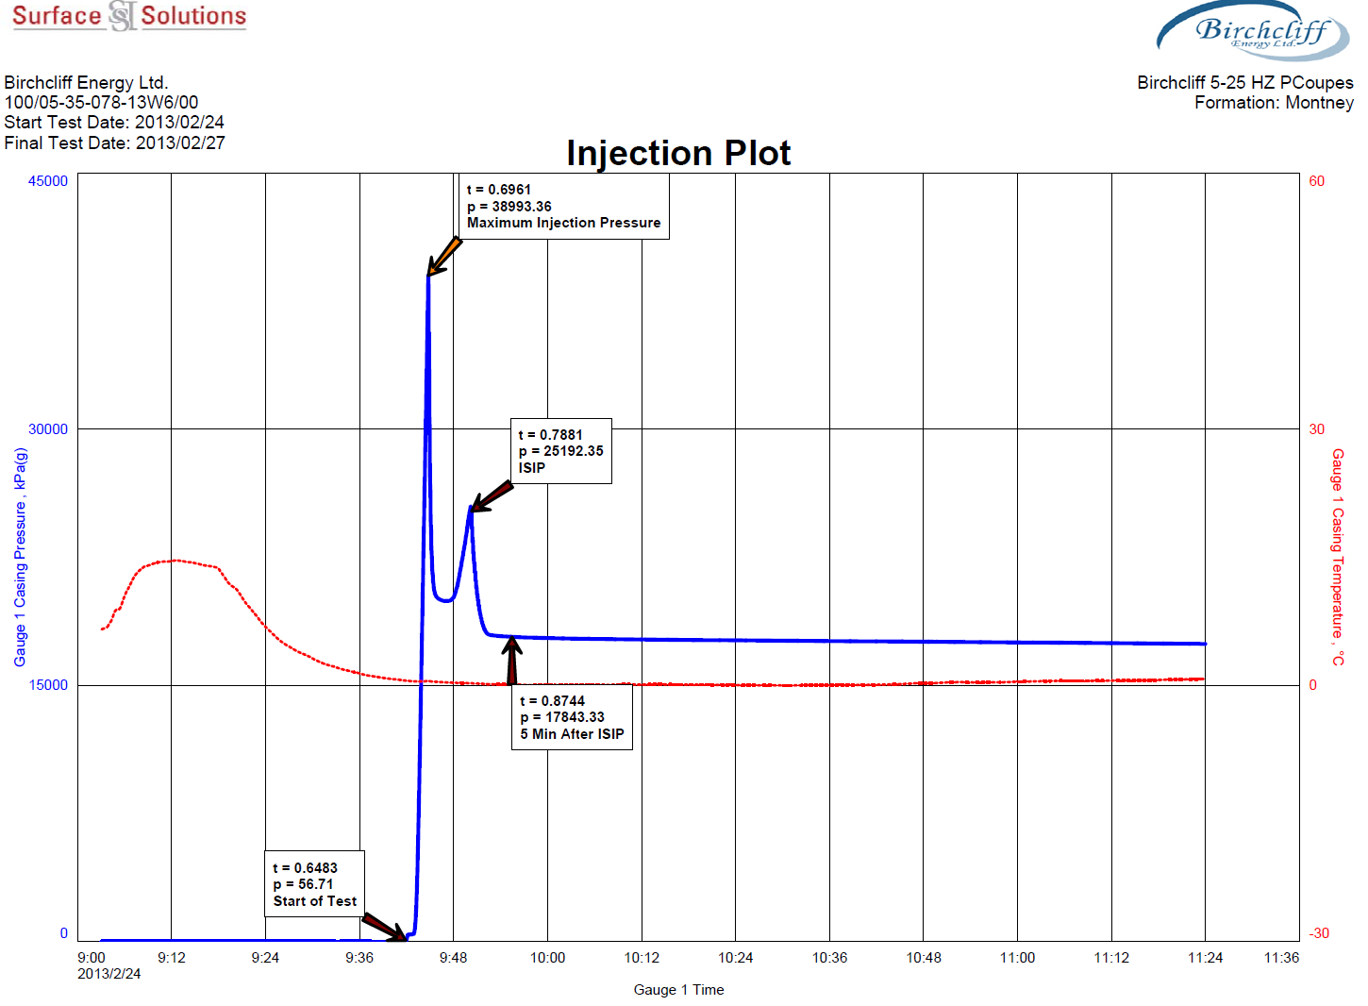
DFIT Overview
4 points from pressure over time injection plot:
Start
Breakdown
ISIP
Closure

Slide 3
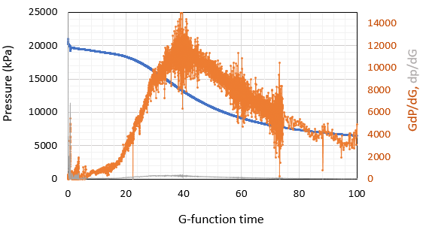
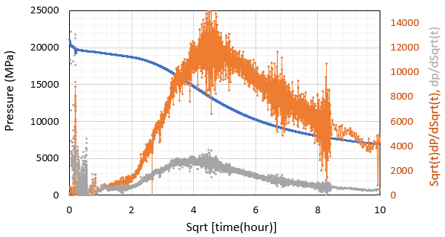
Automatic Point Selection
Start: minimum slope threshold
Breakdown: maximum pressure
ISIP: deviation from post-breakdown slope
Closure: time-pressure differentials

Slide 4
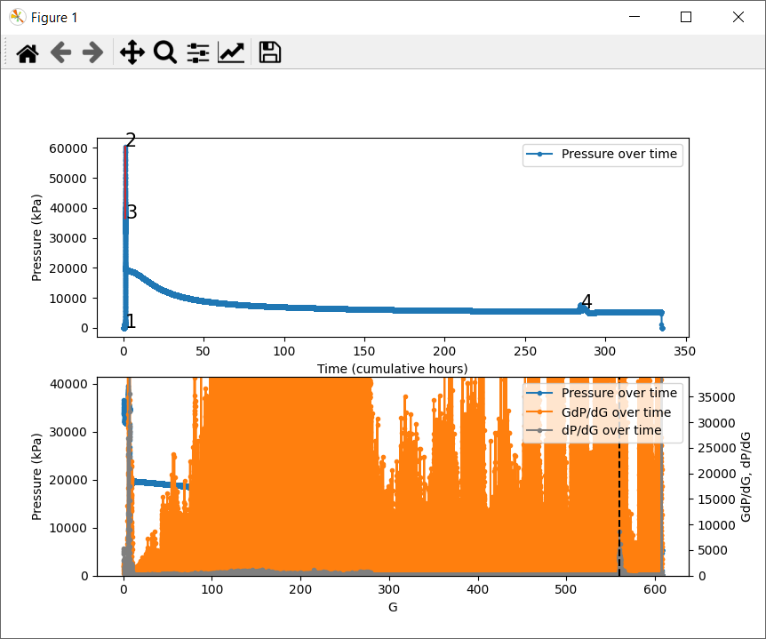
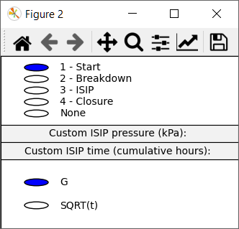
Program Implementation

Slide 5
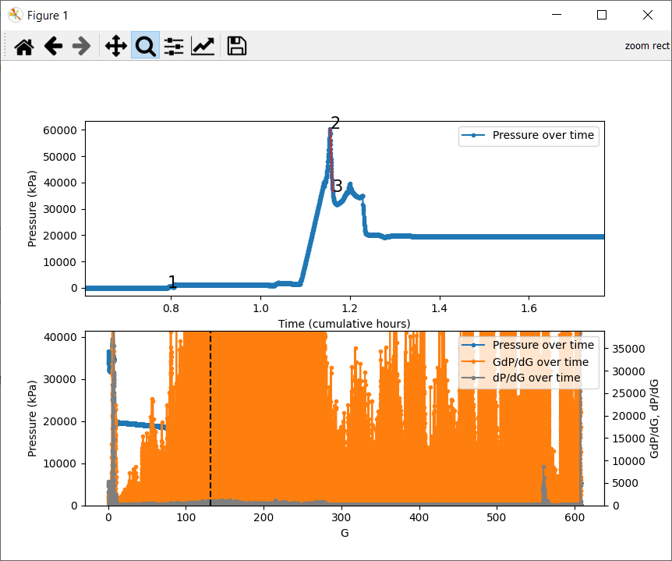
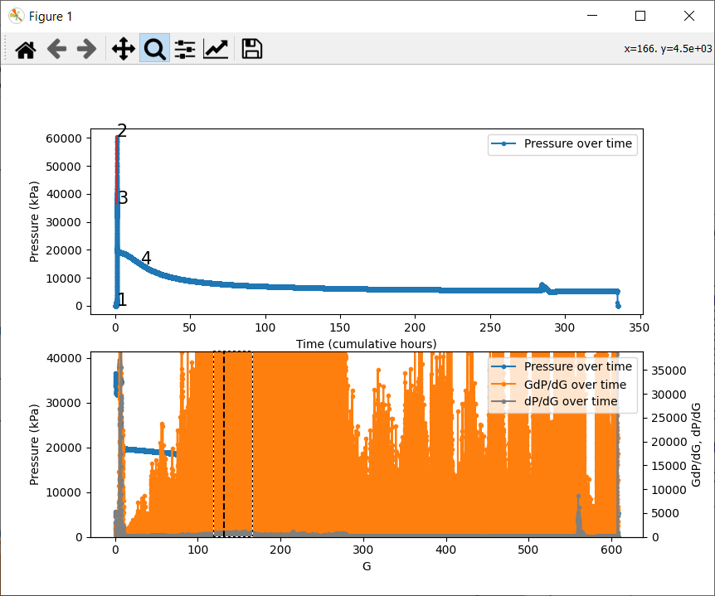

DFIT Interaction
Snap to zoom and point picking

Slide 6
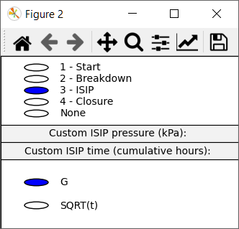
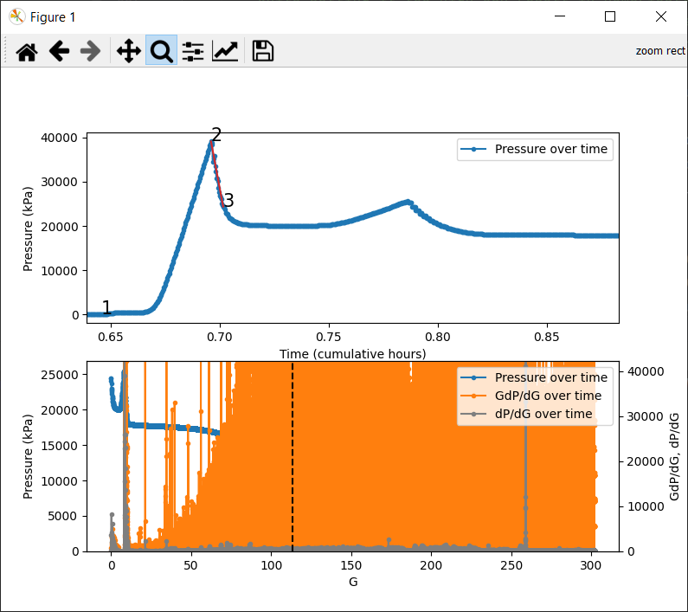
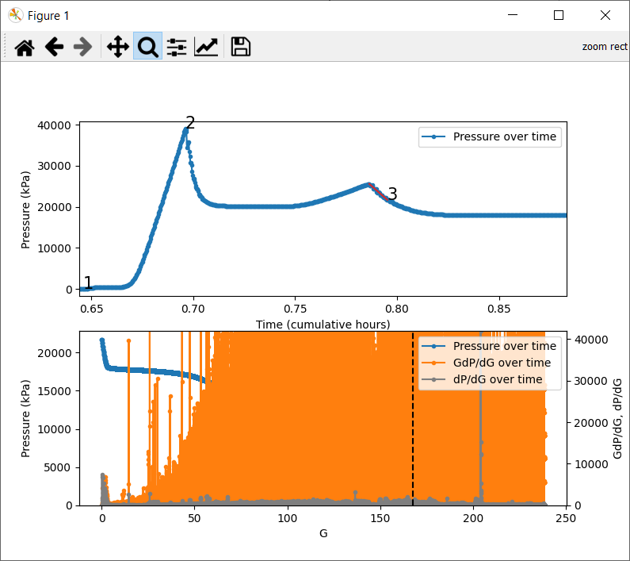
DFIT Interaction (2)
Independent snap to zoom

Slide 7
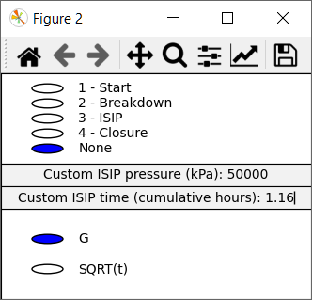
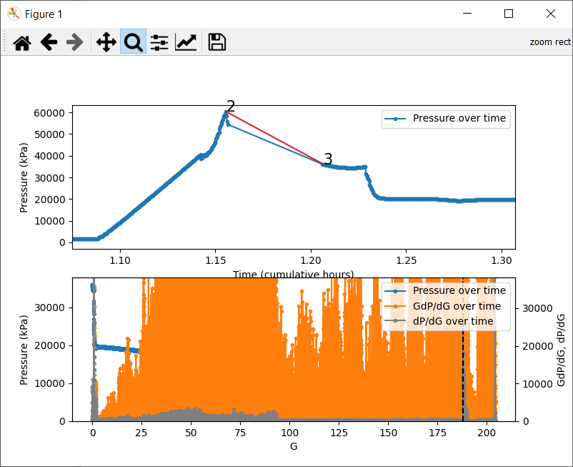

DFIT Interaction (3)
Custom ISIP

Slide 8

Closure Point Selection Details
Based on local density outlier analysis
Eliminate points with extreme rolling variance based on moving window statistics then take max
Better experimental results than simple max value or polynomial interpolation

Slide 9
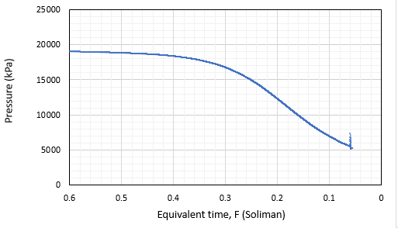
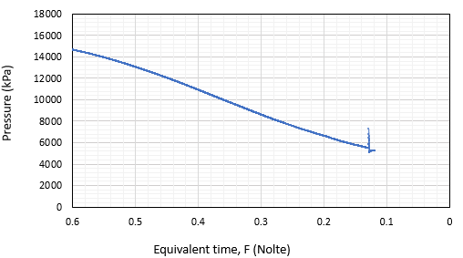
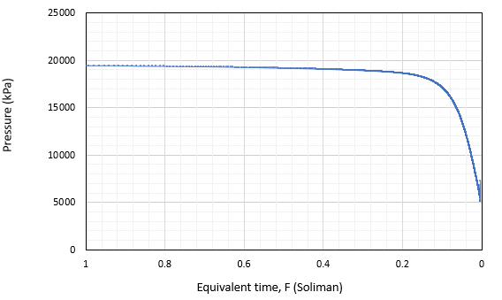
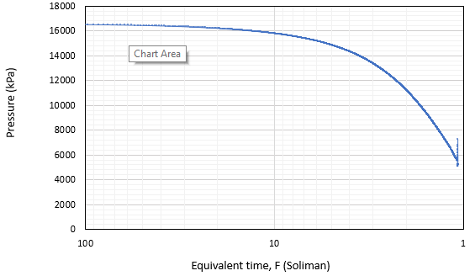
Pore Pressure
With the 4 points from the first part of the program, pore pressure can be calculated

Slide 10
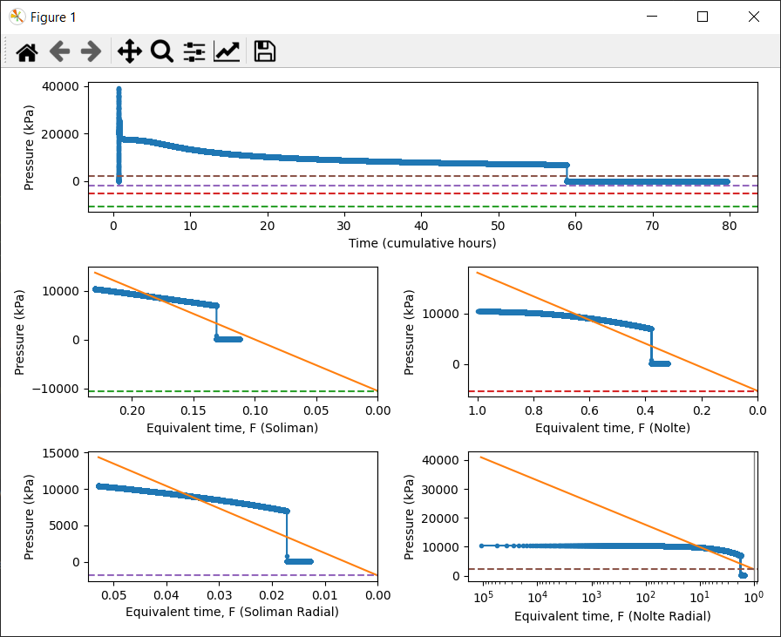
Program Implementation (2)
Following user interaction with 4 DFIT points

Slide 11
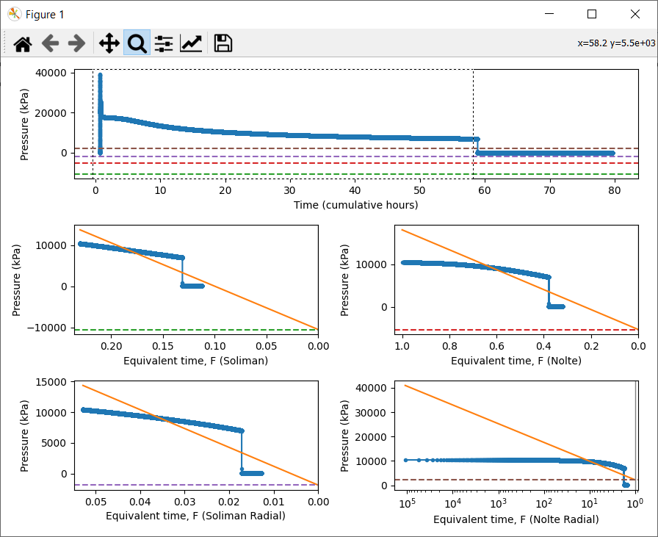
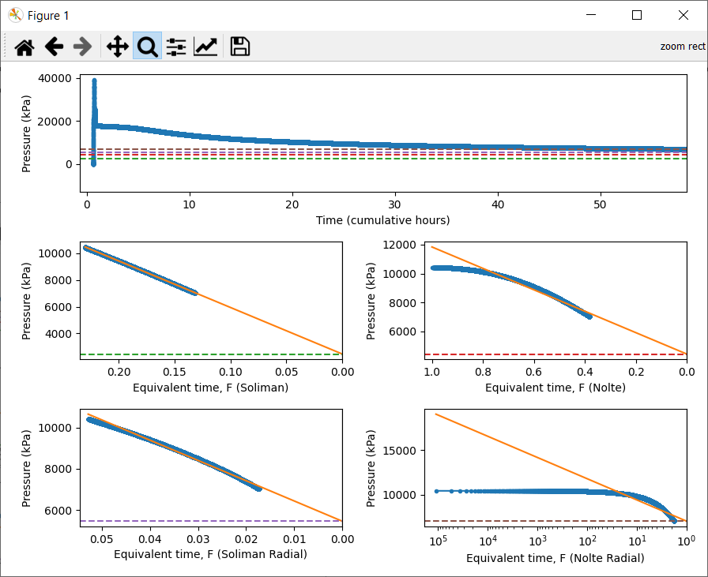
Pore Pressure Interaction
Global region selection for data filtering

Slide 12
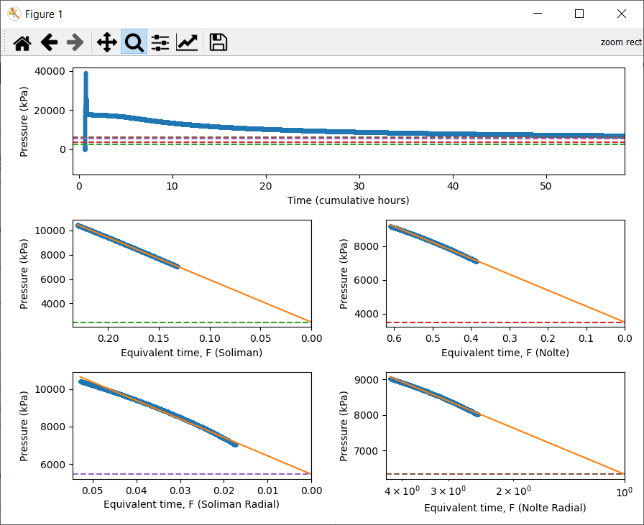
Pore Pressure Interaction (2)
Local region selection for data filtering

Slide 13
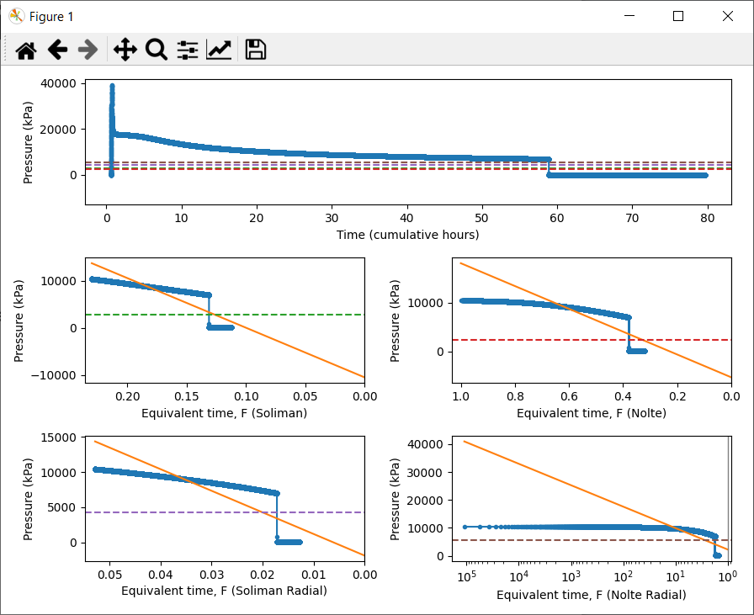
Pore Pressure Interaction (3)
Manual intercept override

Slide 14
Conclusion
Program successfully achieves its purpose of making DFIT analysis more efficient than alternative methods (Excel, etc.) through the use of software that scales to large datasets and custom ways of interacting with data
From a technical perspective the use of Python’s Matplotlib library is the largest roadblock to further development since it is not designed for interactivity
Other areas of improvement are automatic selections of ISIP and closure – selection parameters aren’t directly accessible through program UI and better approaches may be possible in general

